Slide 1
CMPS 3160
Freaky Financials
By Arzaan Singh and Ethan Kraus
https://ethank47.github.io/

Slide 2

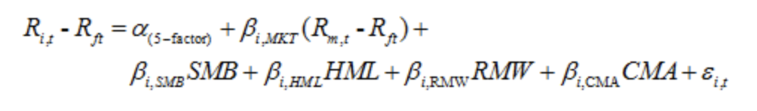
Introduction & Research Question
E
Introduction and Motivation
As both Comp Sci and Finance majors who LOVE 💸🤑, we wanted to explore the intersection of the two fields by analyzing and modelling our portfolio.
Fama-French 5-Factor (FF5) Model is an asset pricing model that seeks to explain the expected returns of stocks.
Research Questions:
Using historical stock prices and FF5 data, find our portfolios feature coefficients.
Using our feature coefficients, predict and simulate the next year’s returns for our portfolio
Notes:
market risk, size, value, profitability, and investment.

Slide 3
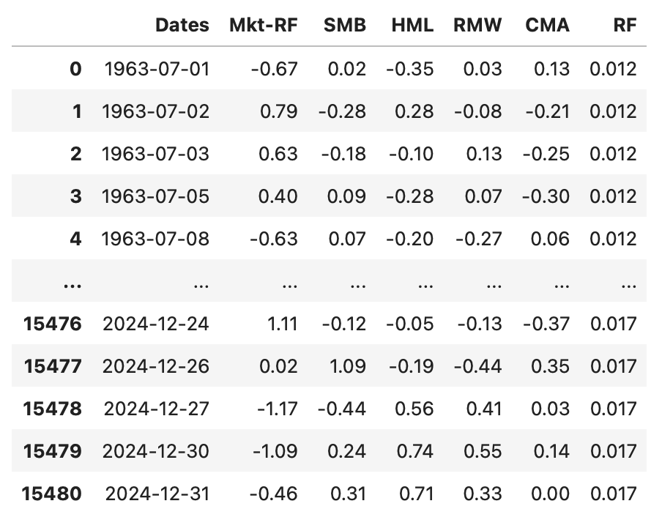
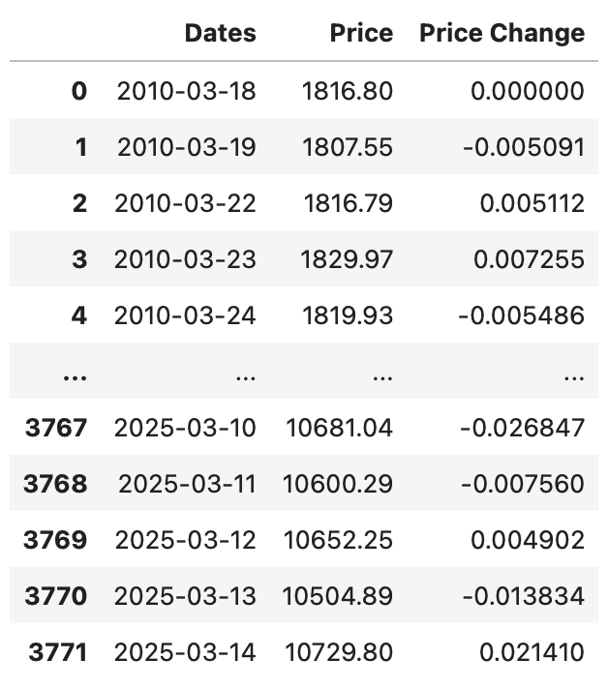
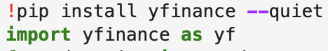
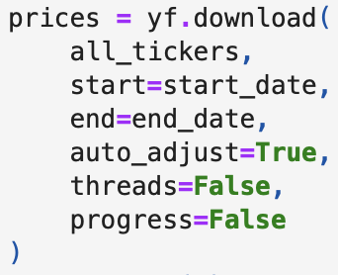
Data Collection & Sources
E
We collected Data from 3 main sources:
Stock Price Data from Yahoo Finance API
S&P 500 Data from Capital IQ
Research/FF5 Factor Model Data from Tuck Dartmouth Library
Notes:
While we could have simply gotten the index returns from Yahoo Finance, we wanted to use additional sources to practice data collection methods
Unfortunately the FF5 Data is only created by Dartmouth and although a good research project would be finding out how to estimate those factors we just got it from their website.

Slide 4
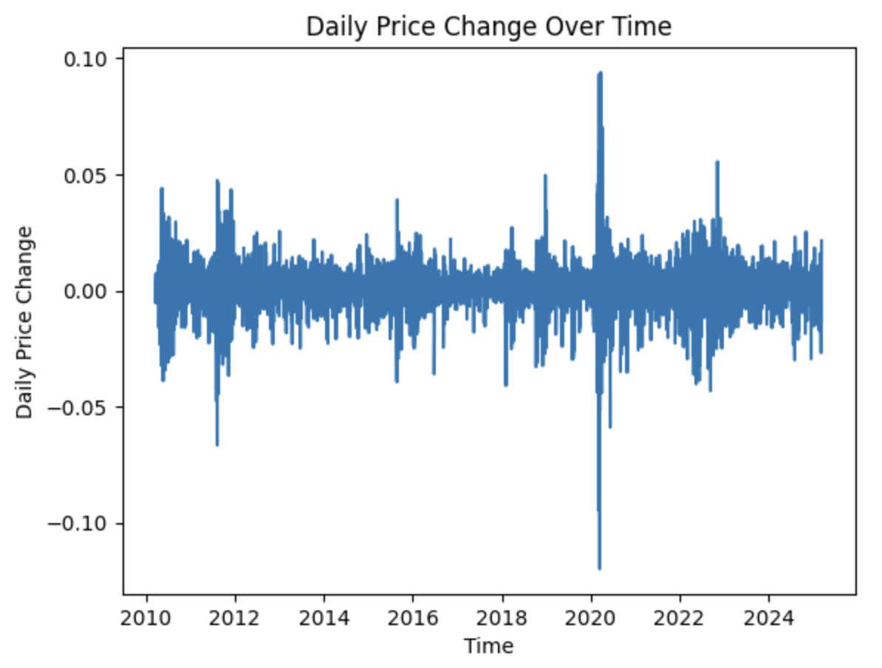
Data Extraction Transform Loading
A
Loading in FF5/SPY Data from CSV file and cleaning it to Tidy data
Validated our FF5 data by comparing SPY daily returns to FF5’s Market Risk Premium (which is a derivative of market returns)
Loading in Stock Prices from yfinance API and constructing our portfolios by dynamically weighting stock depending on whether they were publicly traded or not.
Notes:
Loading in FF5/SPY Data from CSV file and cleaning it to Tidy data
Both files formatted as time-series with Datetime as index (cleaning for format)
FF5 Data needed to be converted from percentage to decimal
SPY Daily Price Returns needed to be derived from Price (fillna for initial pct.change)

Slide 5
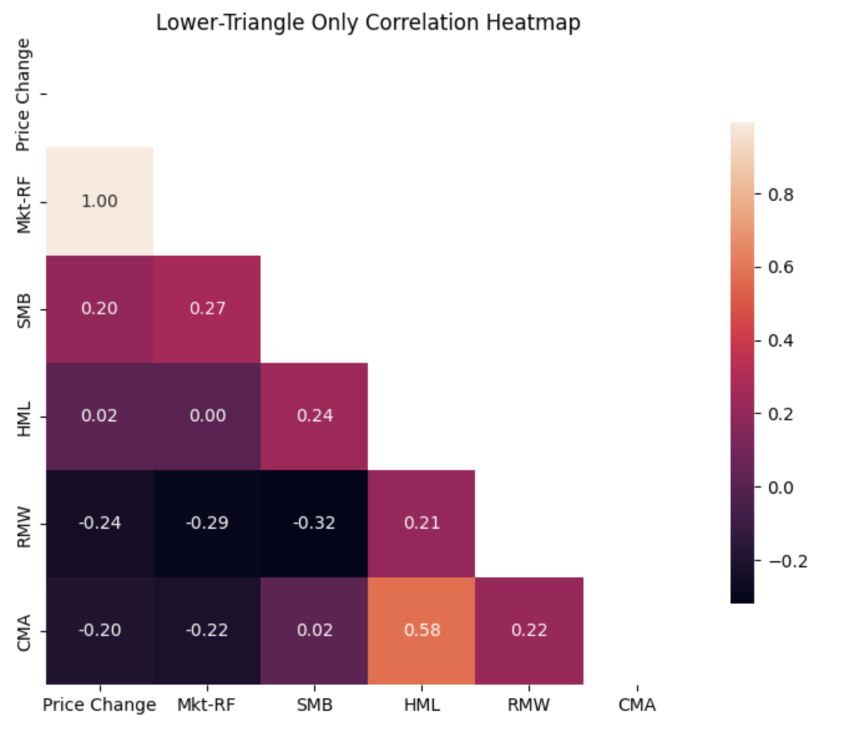
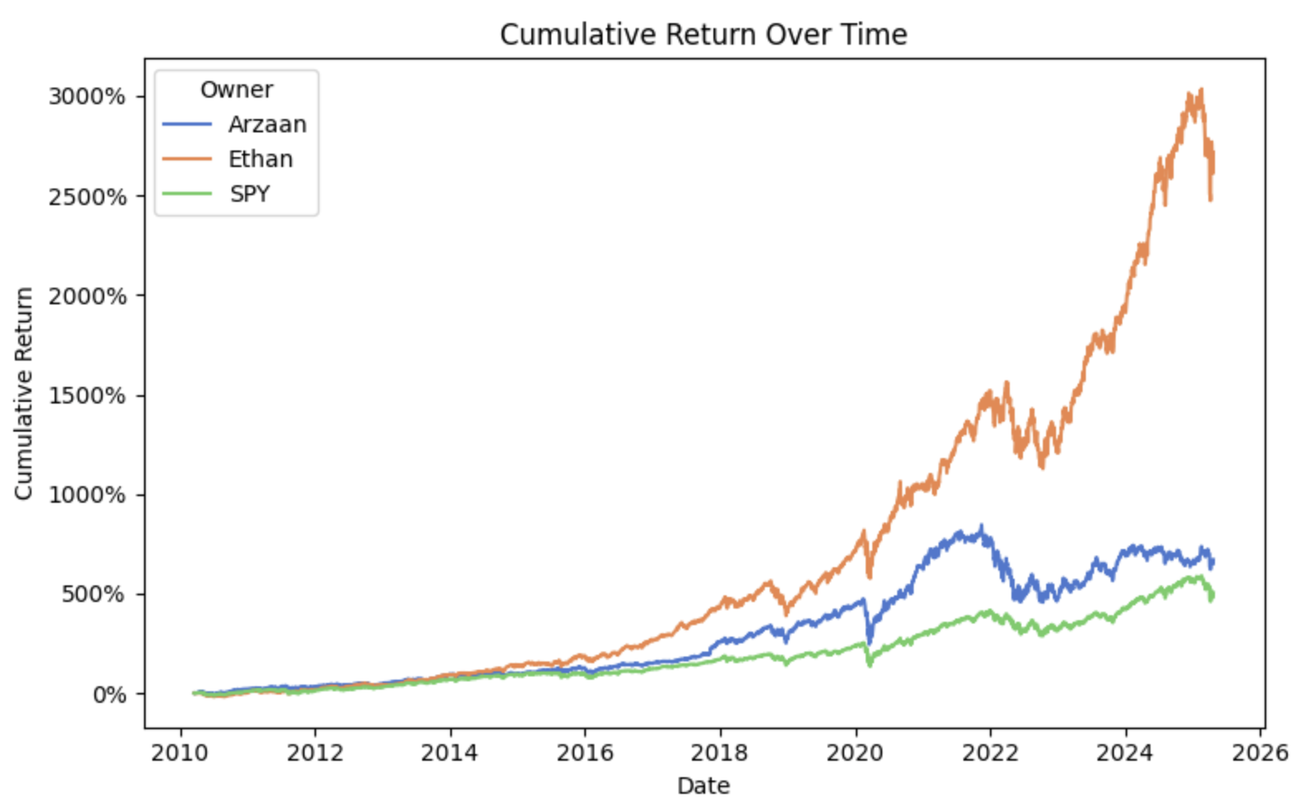
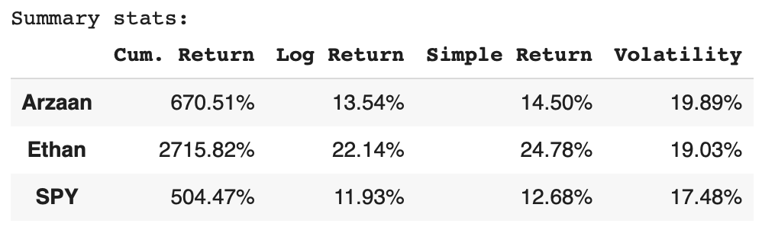
Exploratory Analysis & Data Visualization
A
We first looked at the rough correlation between FF5 Factor data and SPY daily returns using a heatmap.
And then we plotted our portfolio returns over time, Ethan performed much better than Arzaan!

Slide 6
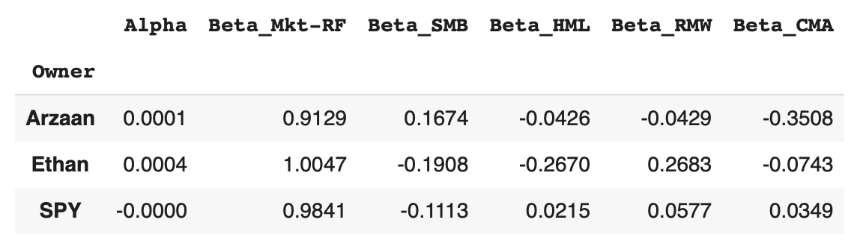
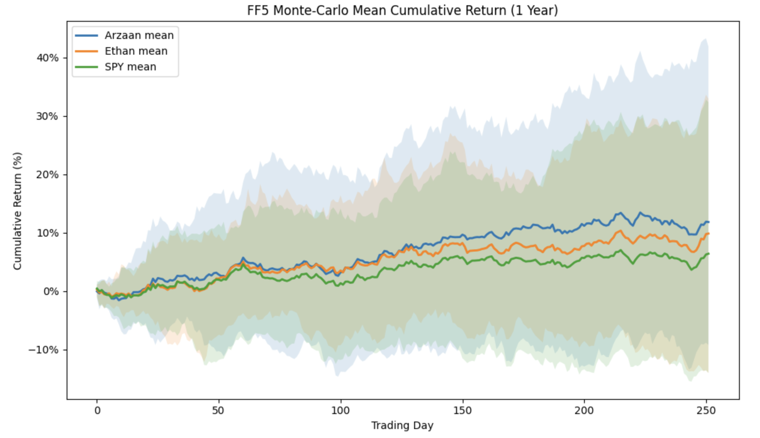
Modelling and Analysis
A
We used K-Cross Validation and Linear Regression to find feature coefficients - finding our model.
Monte-carlo simulations with idiosyncratic risk (unsystematic variance) to predict FF5 factor values, which we then used to predict our daily portfolio returns

Slide 7
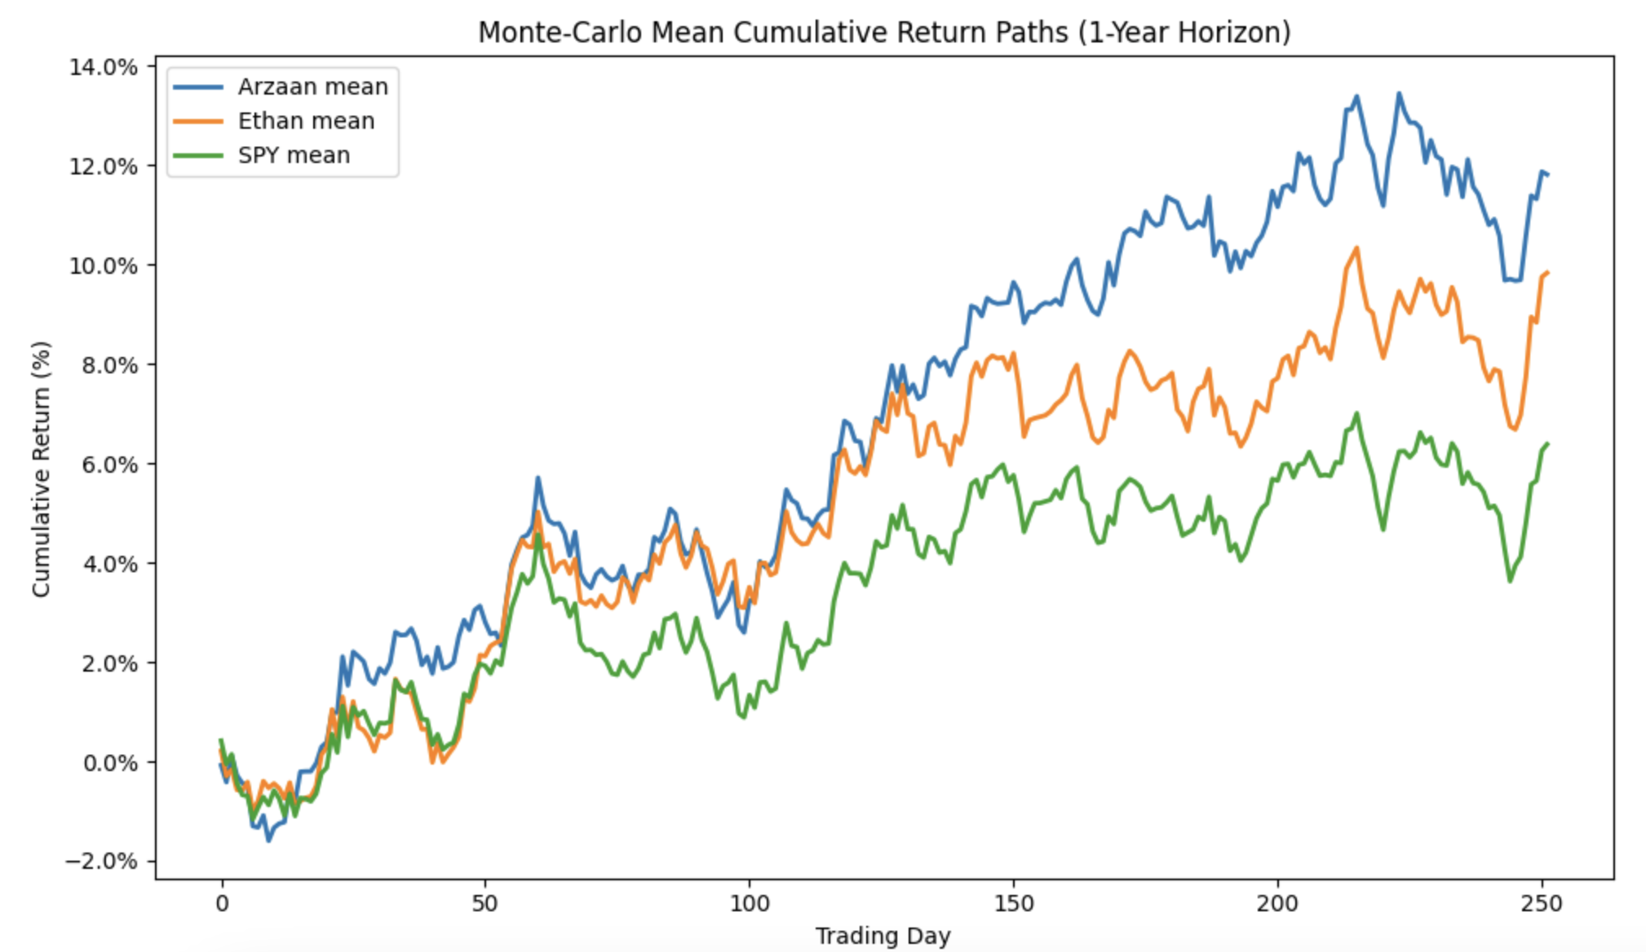
Final Result - Future Predictions
A

Slide 8

Conclusion and Next Steps
E
Key Insights:
Higher exposure to profitability (RMW) and conservative investment (CMA) factors helped drove Ethan’s past portfolios performance.
FF5 model validation showed a strong 0.9958 correlation with market returns, confirming reliability of the underlying data.
Next Steps:
We could add more complex mean-volatility distributions to simulate the real world
Compare with other asset pricing models to find the best one

Slide 9
Thank You For Watching

